Slide 1
INVESTMENT CASE STUDY SUBMISSION
Group Name:
Srinivasan. G
Naveed.J
Denny.J
Kumar.A

Slide 2
Sparks Fund Business Goal
To make investments in a few companies.
To invest between 5 to 15 million USD per round of investment
To invest only in English-speaking countries
To Find suitable sector and companies for investing
To invest where most other investors are investing

Slide 3
Data Analytics methodology
Data Cleansing
Analyze Data
Cleanse
Analytics
Baseline Master
Apply Rules
Presentation
Create Plots
Visualize
Transform
Evaluate Each Checklist
Results

Slide 4
Assumptions
Data provided include even “Closed” status companies
This has not been removed from our analysis as amount of closed companies in the filtered count has been found to be negligible
Assumed that they need to be ignored in our analysis
Data provided includes companies as old as 1982 when they were last funded
Understand that the Business Goal has been to invest where other companies are investing but the data found in this category has been found to be negligible

Slide 5
Data Cleansing
Load companies, rounds2 and mapping data in to data frames (‘iso-8859-1’ format)
Remove unnecessary special characters
Clean up ‘permalink’ of companies and rounds 2
Use ‘permalink’ columns to merge to a master data frame
Remove duplicate rows and identify unique number of rows
Remove unnecessary columns which are not required for analysis from master
Impute missing name columns with appropriate values
Verify percentages of ‘NaN’ values in each columns
Remove rows for the columns impacted or null values
Produce good percentage (approximately 77%) of cleaned data available for analysis

Slide 6
Data Analytics
Fund Type Analysis
Choose one out four potential investment types below based on Average Investments
Venture, Angel, Seed and Private Equity
Country Analysis
Find out the countries with the highest amount of funding for the chosen investment type based on
Top Investment Fund Type
Top 9 and then Top 3 English speaking countries
Sector Analysis
Find out eight main sectors (based on primary sectors)
Top Funding type and investment amount in the range of 5 M to 15M USD
Top 3 English speaking destination
Highest number and average of investments
Evaluate the metrics fund type, destination and sectors where spark funds can invest in.

Slide 7
Presentation
Different Plots are created in the below order
To understand the distribution of total investments percentage and average total investments across all Venture types
To understand the distribution of total investments percentage and average total investments across the 4 fund types viz. angel, seed, private equity and venture
Since strategy is to invest in 5-15 Million USD, focus on this Raised Amount of Funding Types
To understand Top 9 English speaking countries of this Funding Type
To understand Top 3 amongst this Top 9 countries
To choose Top 3 sectors in terms of number of investments in this Top3 countries

Slide 8
Globally it shows all Venture Types with the Total Investments in % and Average Investments in USD

Slide 9
Venture Type has the average Investment amount between 5 M to 15 M USD

Slide 10
Top 9 English Speaking countries Invested in Venture Which of which Top3 happens to be USA, IND and GBR

Slide 11
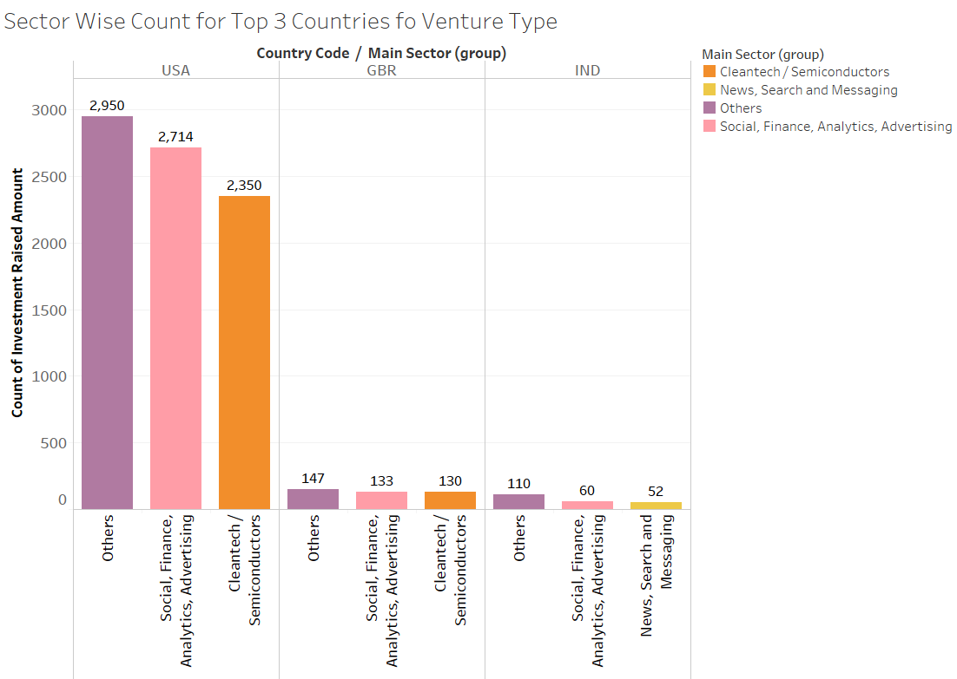
Top 3 Invested Sectors of Top 3 Countries

Slide 12
Conclusion -- Recommendation
Considering Spark fund’s Investment Strategy of investing 5M to 15M USD and investing in sectors where other investors are investing we recommend that Venture Funding Type of Companies be chosen for Investment
Amongst the top English speaking countries it has been found that USA , GBR and IND top the lists globally where they invest.
Country wise and sector wise we recommend the following sectors can be chosen for investment in Venture Type of companies
USA - Others / Social, Finance, Analytics & Advertising / Cleantech/Semiconductors
GBR - Others / Social, Finance, Analytics & Advertising / Cleantech/Semiconductors
IND. - Others / Social, Finance, Analytics & Advertising / News, Search and Messaging

